Slide 1
Interest Groups Who We Are and How to Get Involved
Presented by
IG Name Here

Slide 2
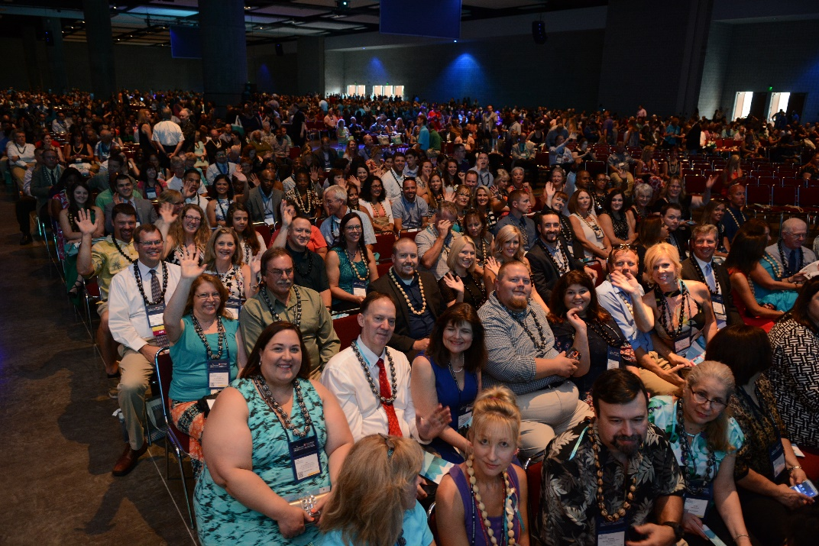
Who We Are
The Institutes CPCU Society is a community of credentialed insurance professionals who promote excellence through ethical behavior and continuing education.
20,000+ members.
120+ chapters.
14 specialty interest groups.
Members hold the prestigious CPCU® designation.
CPCU is a registered trademark of The Institutes. All rights reserved.

Slide 3
What We Do
We Learn
Membership provides resources and CE opportunities in both technical and business skills.
CE workshops
Annual Meeting
Free webinars
Insights professional journal
We Lead
Members are authors, speakers, mentors, committee chairs, webmasters, directors, treasurers, presidents and more!
We Have Fun!
Local chapters and national events provide opportunities to network and give back to the community.

Slide 4
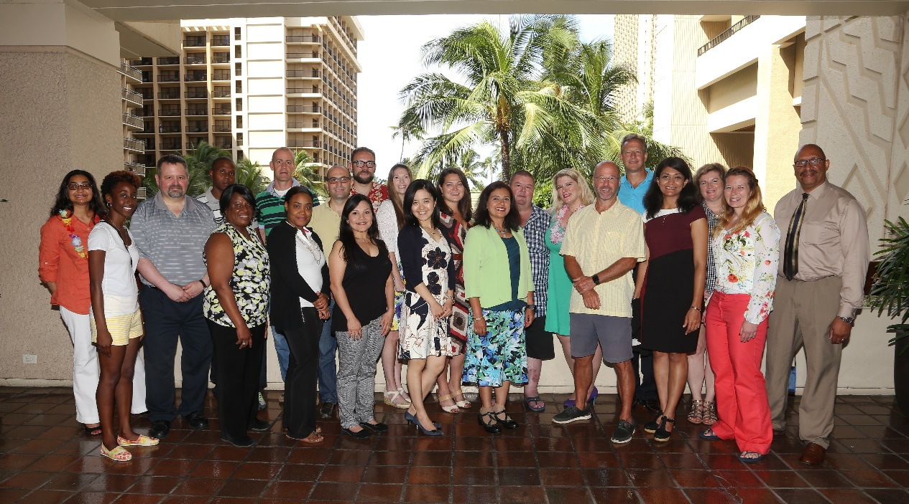
Our Interest Groups
Represent specialized views of the industry
Help members connect with like-minded professionals
Deepen members’ insight and vision
Notes:
The CPCU Society's 14 interest groups (IGs) are designed to deepen members’ professional insight and vision. We provide dynamic, specialized views of the risk management and insurance industry across disciplines and functional areas.
IG involvement creates invaluable opportunities for members to connect and network, as well as access informational resources, best practices, and leadership opportunities in our committees.

Slide 5
Our Interest Groups
Agent & Broker | Loss Control
Claims | Personal Lines
Coverage, Litigators, Educators & Witnesses | Professional Experience Resource Group
Excess/Surplus/Specialty Lines | Regulatory & Legislative
Information Technology | Reinsurance
International Insurance | Risk Management
Leadership & Management Excellence | Underwriting

Slide 6
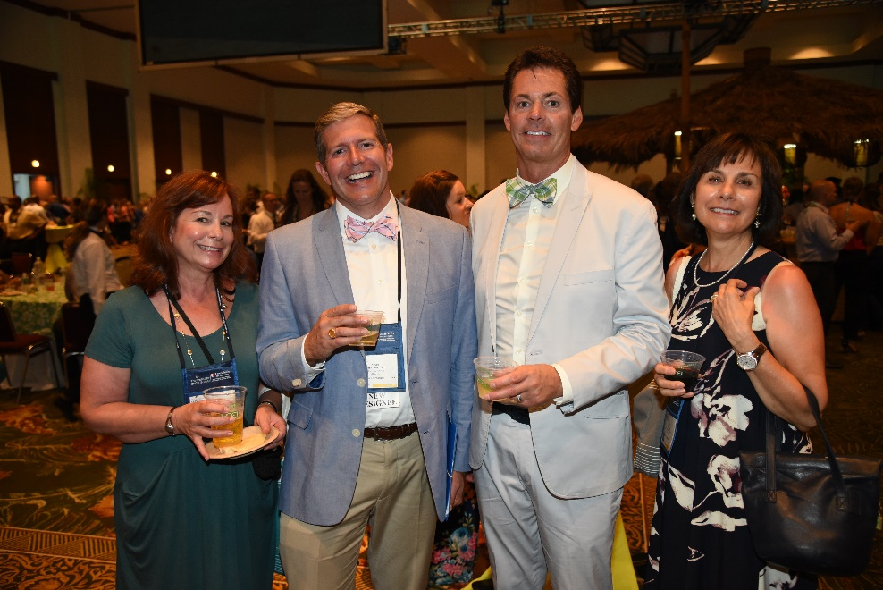
What’s In It For You?
Stay informed on emerging issues that interest YOU!
Set your IG preferences to receive notifications from IG leaders for:
Live webinars on the latest trends organized by your IG
New published articles from your IG
Annual Meeting events (e.g., networking happy hours, roundtable discussion sessions and speakers sponsored by your IG)
Local workshops, symposia and networking in conjunction with chapters
Notes:
When you join an interest group, you sign up to get notifications on professional development that interests YOU!
Each Interest Group is a little different, but we all do similar activities to keep you informed and ahead of the curve, such as writing articles, producing free member webinars, and partnering with local chapters for events. We are also all very active at our Annual Meeting producing sessions and networking.
Come get to know us this year in San Diego- meet us for breakfast or lunch at a discussion Roundtable, check out our special sponsored sessions, or catch up with us to find out where we’ll be happy hour-ing after sessions are over!

Slide 7
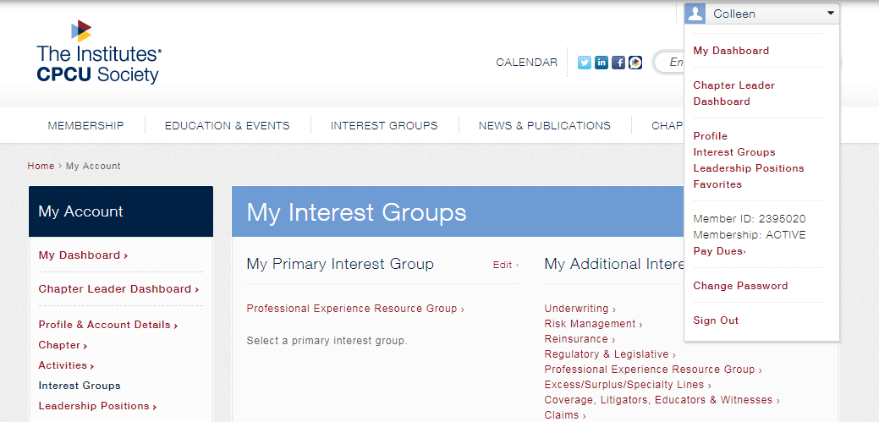
Select Your Interest Group
Log in to CPCUSociety.org and select “Interest Groups” from dropdown menu under your name
Choose one primary IG and as many secondary ones as you wish
Notes:
To join an interest group and set your group preferences, log in to the CPCU Society website and update your interest groups under your profile, found on the top right. Your primary interest group tells us the interest that most aligns with your work, however you can sign up for additional interest groups as well.
Based on your preferences, our IG leaders will keep you updated on new webinars, articles, networking, sessions and more.

Slide 8
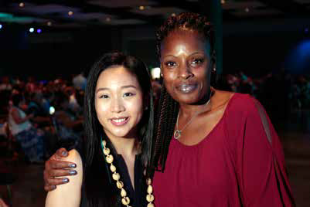
Become an Interest Group Leader
Want to get a little more involved?
Boost your leadership skills by becoming a:
Social media champion: Help us keep the conversation flowing!
Author: Write an article to be published online or in our quarterly professional journal, Insights.
Speaker: Share your subject matter expertise in a webinar or at our big Annual Meeting.
Committee member: Meet regularly with other IG leaders to plan new events and activities.
Committee leader: Take your resume to the next level by becoming a chair, webmaster, secretary, membership director, and more!
Notes:
Anyone can be a leader- whether you come from claims or underwriting, whether you are a new designee or a retiree, whether you are in the US or abroad, whether you are an introvert or an extrovert. We have an opportunity for you to get involved!
Here are ways that you can get even more involved.
**Talk a little about your decision to get more involved in an interest group or share the story of how you got involved in your committee.

Slide 9
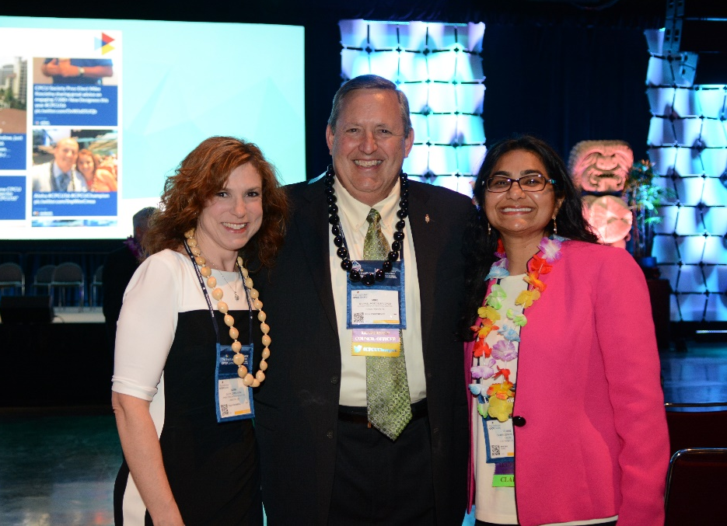
Become an Interest Group Leader
We are always looking for new leaders!
Reach out to any member of your IG leadership committee for more information on getting involved as a committee member, author, or speaker.
Or, for leadership appointment openings, visit:
CPCUSociety.org/membership/volunteer-opportunities
Meet new people. Boost your resume. Make a difference.
Notes:
If you’re ready to jump in in an official capacity as a committee member, please complete an application through the link above. Terms are typically for 3 year appointments. Let’s discuss your skills and what your time availability looks like so we can find a good opportunity for you.
If you are a subject matter expert and want to contribute as a speaker or author, let’s talk so we can find the best avenue to share your expertise!

Slide 10
Our Interest Group (Your IG Name Here)
Write a few bullet points about the activities you’ve done recently
Quick Stats
20
committee members
2,400
IG members
7
conference sessions sponsored
8
Webinars
sponsored
4
Insights
articles
Notes:
Example of talking points:
You may we wondering what we actually “do”, aside from meeting and talking to each other.
We:
Develop articles for submission to the CPCU Society
Develop educational webinars to be offered via the CPCU Society
Develop and deliver educational sessions at the leadership summit and annual conference
Maintain a social media presence to deliver information to members
Recruit new members
And here are some quick stats as of DATE. If you choose to join, you’ll obviously be among good company doing good work. And if life is way too busy to get involved as a leader, sign up for our IG as your primary on the website and we will keep you posted when new updates arise.

Slide 11
How to Get Involved in Our Interest Group
Share contact information for your leaders
Are you looking to fill any roles?

Slide 12
QUESTIONS?
Notes:
Thank you for your time today. Are there any questions?
NOTE: If you can’t answer a specific question, take their email and connect them with the appropriate interest group or IG leader

